Slide 1

Effect of objects in predator-prey lattice systems
CSS 2021
Adrian Fuertes Blanco
Stijn van den Berg
Sven Poelmann
Mario van Rooij

Slide 2
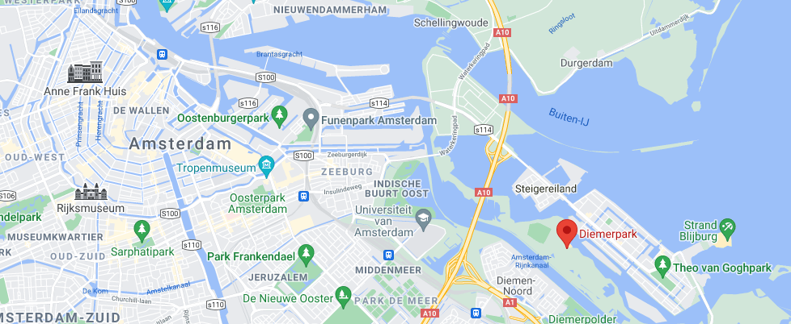
Motivation
Diemerpark
Dogs chasing rabbits
Emergent wave-like phenomenon
Potential phase transitions
Rabbits running around objects
Trapping animals or designing new environments (control populations)

Slide 3

Notes:
Data: bias loud drone, behave different from “natural” situation

Slide 4
Original plan (Agent based)
But, no interesting phenomena

Slide 5
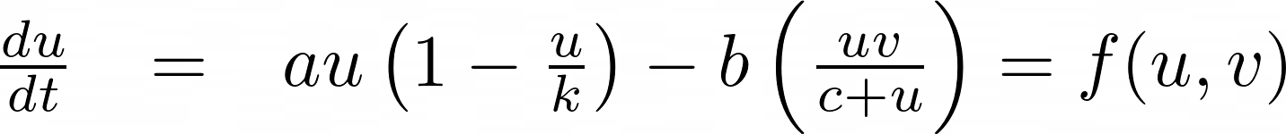
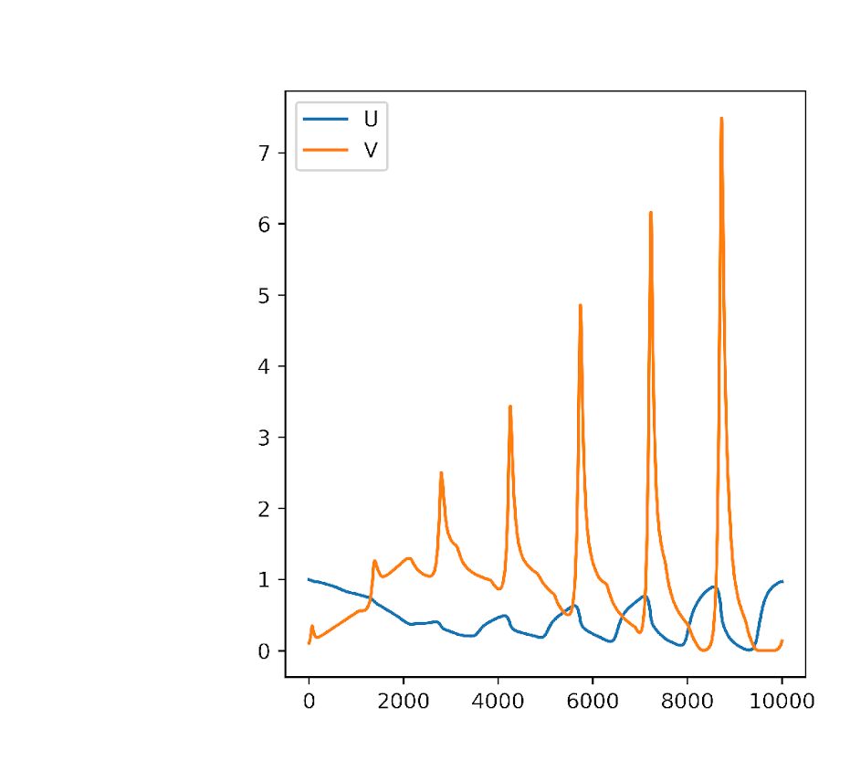
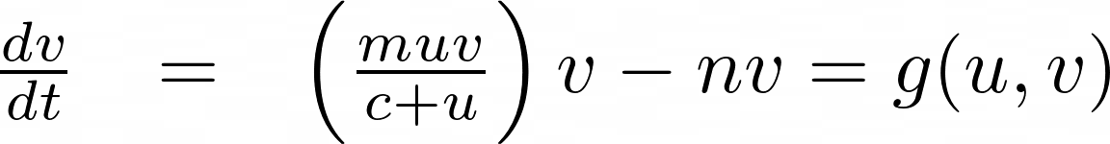
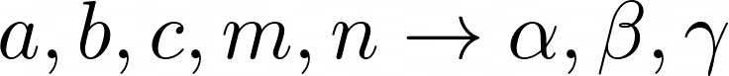

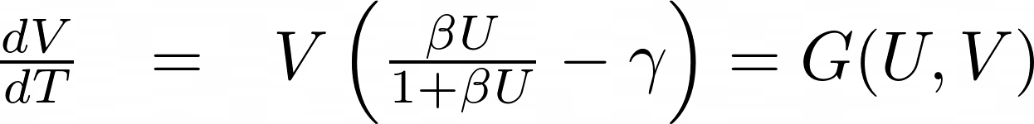
Rosenzweig and MacArthur Equations
Density [a.u.]
Transform variables
Time [a.u.]
Rosenzweig, Michael L., and Robert H. MacArthur. "Graphical representation and stability conditions of predator-prey interactions." The American Naturalist 97.895 (1963): 209-223.

Slide 6


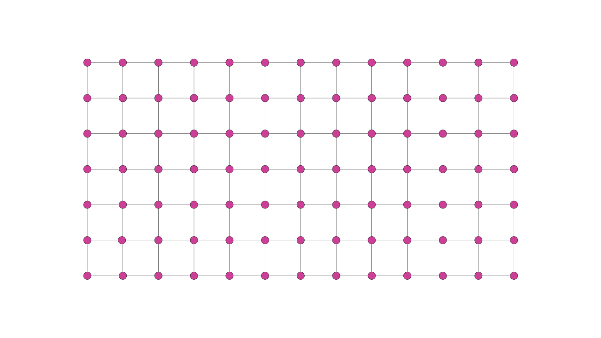
Lattice version
Add diffusion
Represents animal migration
Deterministic
1
1
-4
1
1
Notes:
Deterministic (depends on init condit only)

Slide 7
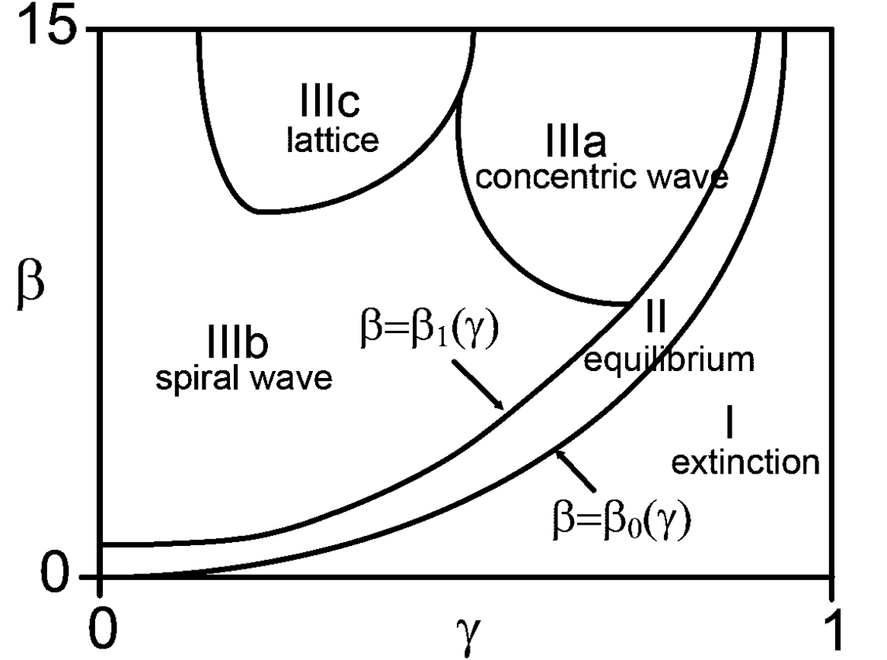
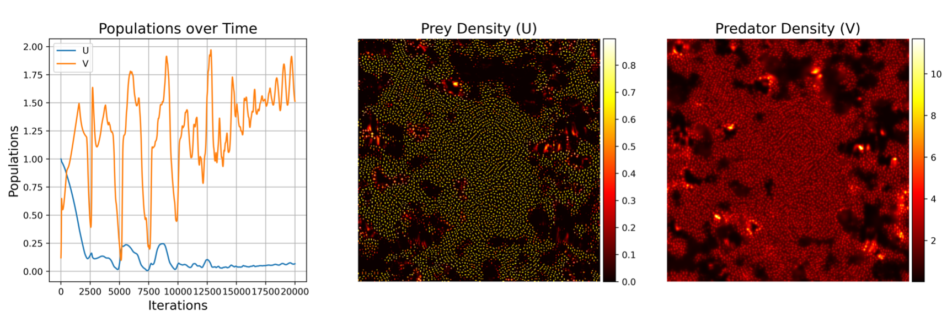
Original results
Nagano, Seido, and Yusuke Maeda. "Phase transitions in predator-prey systems." Physical Review E 85.1 (2012): 011915.
Notes:
One figure at a time with arrow

Slide 8
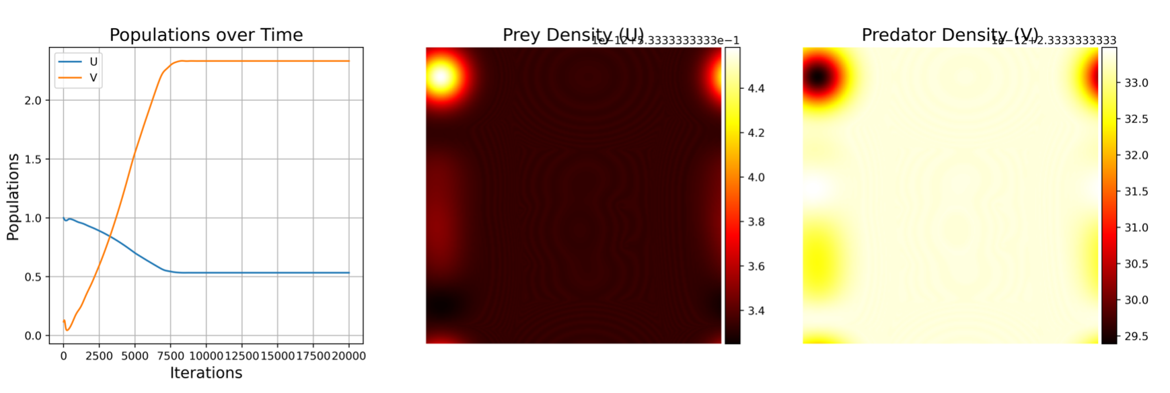
Original results
Notes:
One figure at a time with arrow

Slide 9
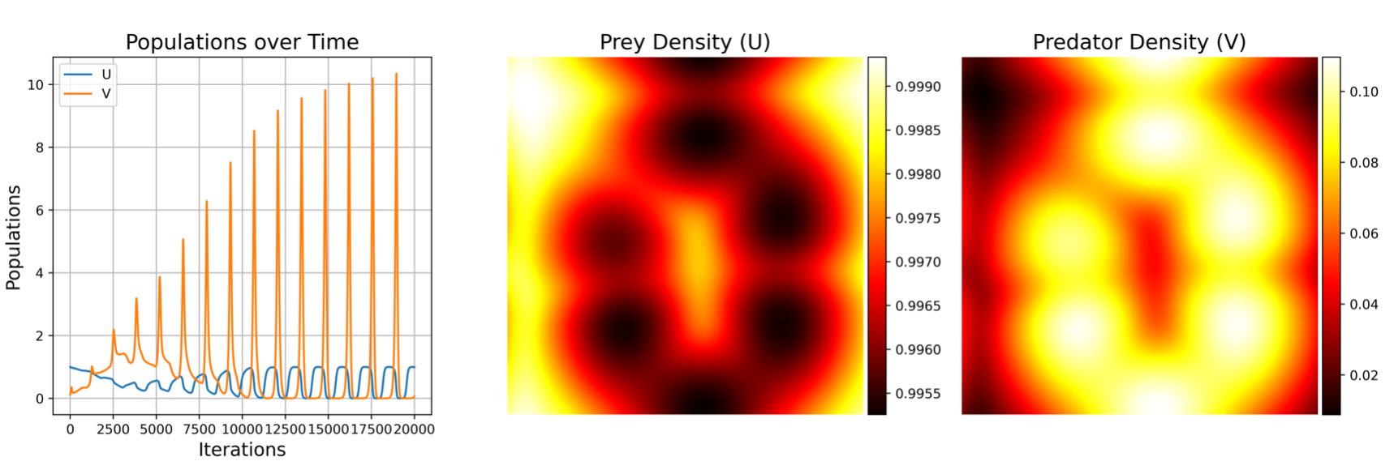
Original results
Notes:
One figure at a time with arrow

Slide 10
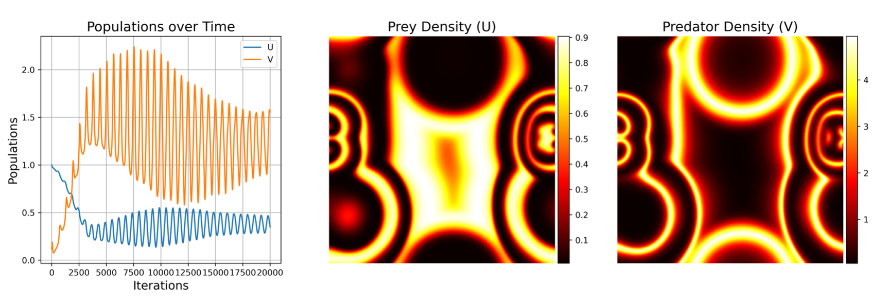
Original results
Notes:
One figure at a time with arrow

Slide 11
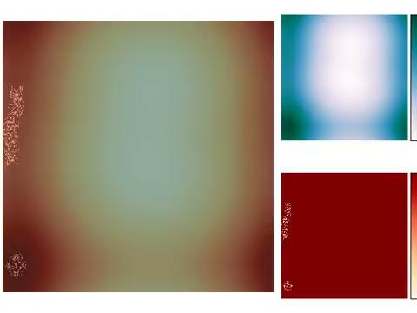
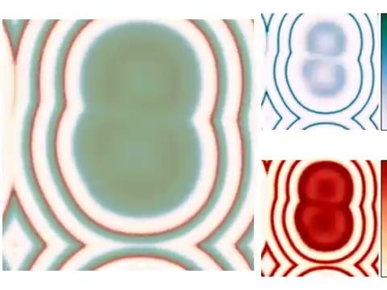
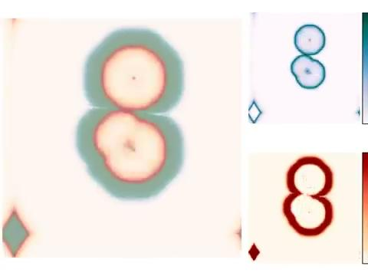
Example plots

Slide 12
Adding objects
object
1
1
With object
1
-4
1
1
-3
0
1
1

Slide 13

Hypothesis
The area of the extinction phase in the phase diagram increases when objects are added in the lattice.
Notes:
Talk about reasoning, and designing landscapes to see how objects influence dynamics

Slide 14
Results
Notes:
So as mario already explained we will be adding objects to the simulation to figure out how the model reacts. Here we already have a video of the simulation with the added circle. And see some clear interaction between the simulation and object.

Slide 15
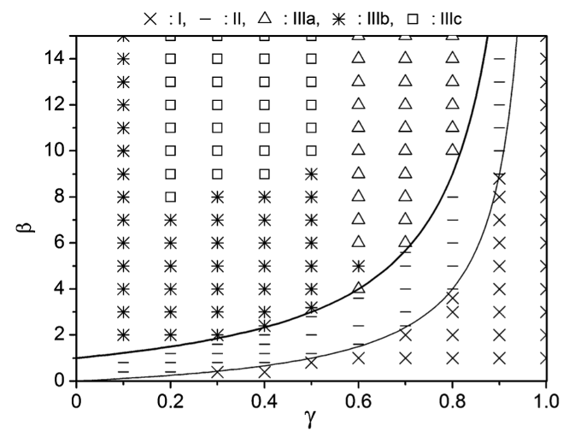
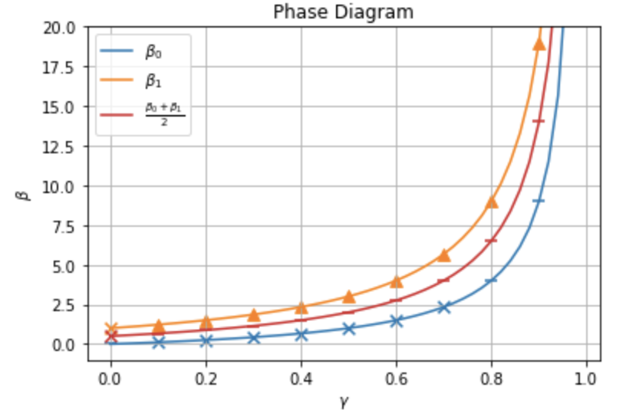
Results
Notes:
By looking at the graphs, as shown earlier we can determine to which region the results belong. Here is another version of the different regions markered by different symbols. These lines represent the analytical values for which either extinction takes place, or an eq is reached. We see that slightly above the line different behaviour is seen the below, such as oscillations as expected.
We ran the simulations with the given values for beta and gamma but with the object and got the following results. we clearly see that the regions are shifted, we see eq happing where extinction should happen, and oscillations where eq should happen.

Slide 16
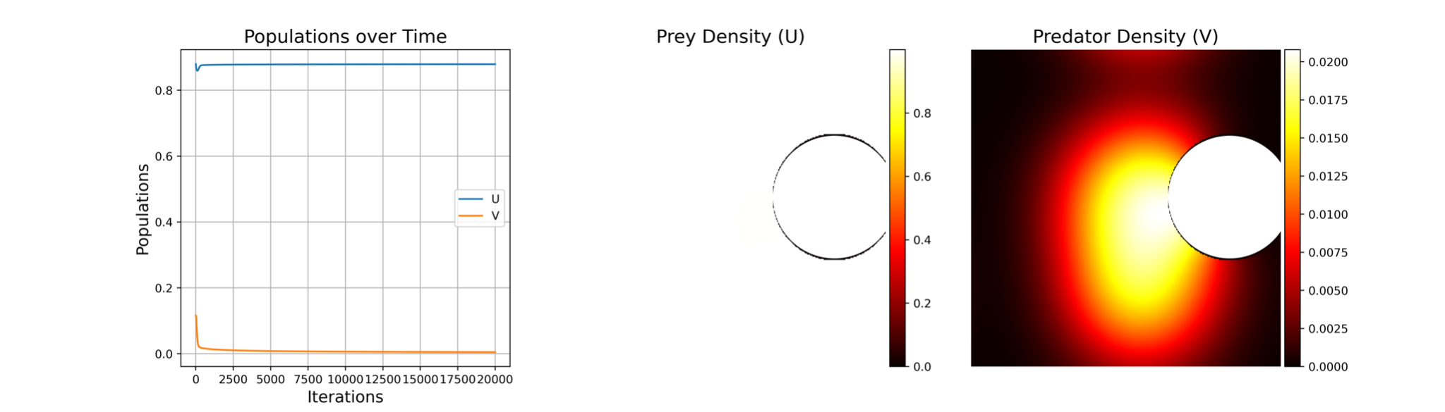
Some examples
Notes:
Here are some examples: it is clear that the behaviour changes. Even when more iterations are used, to make sure enough time was given for extinction to occur.

Slide 17
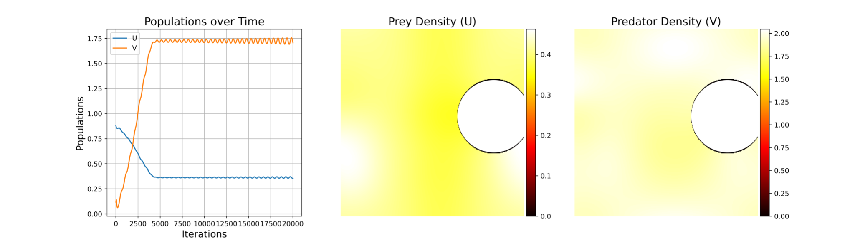
Some examples
Notes:
Here are some examples: it is clear that the behaviour changes. Even when more iterations are used, to make sure enough time was given for extinction to occur.

Slide 18
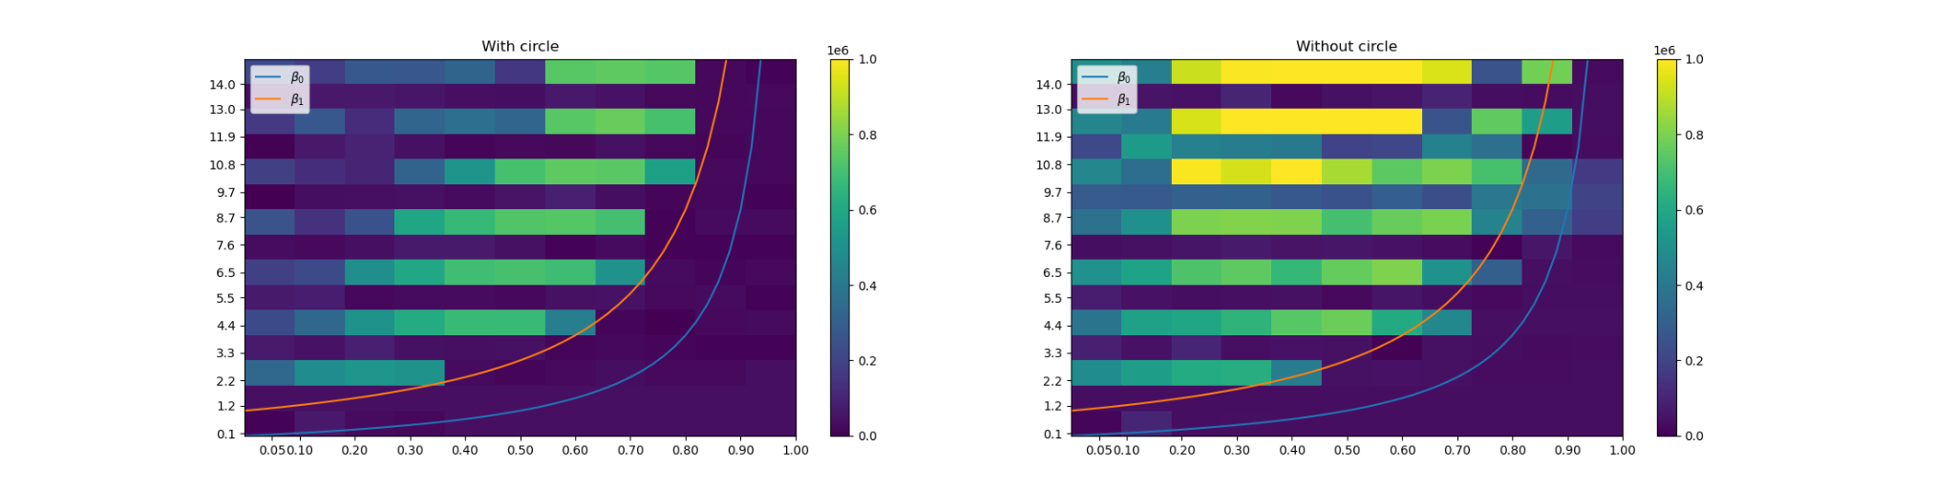
Complexity changes
Corrected for removed complexity of circle
Notes:
Similarly we see that the complexity changes. We measured the kolgomorov complexity by simply saving the images and looking at the size of the save, we accounted for the circle, so that the circle itself doesn’t influence the results. We see indeed hat the complexity changes and that the bright yellow area where the lattice normally form cannot be seen when the circle is added. However, in the regions around the lines we see a different results the complexity lower, in contrast to what we saw before

Slide 19
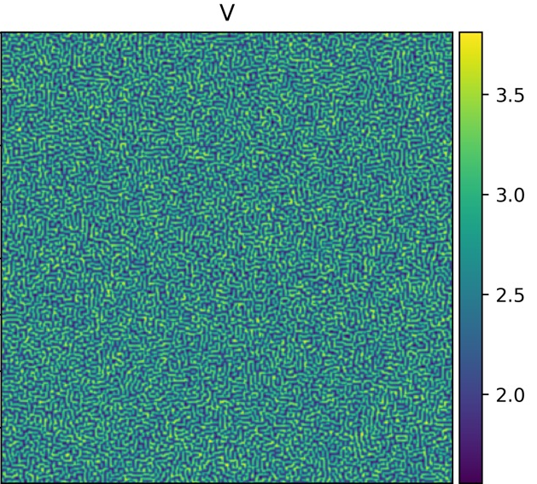
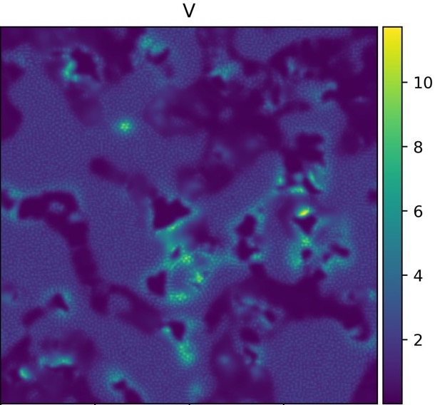
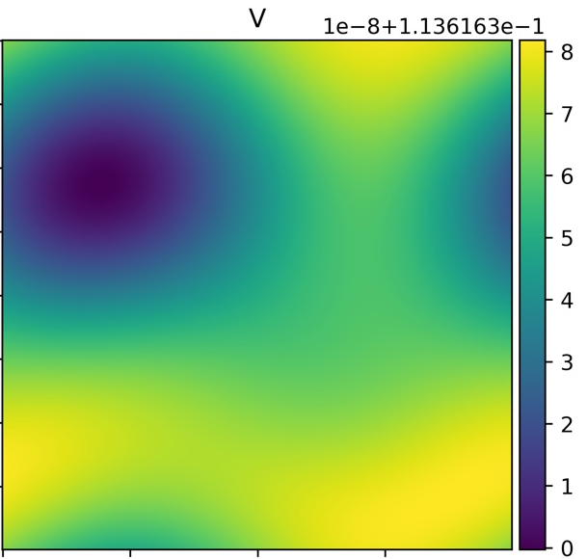
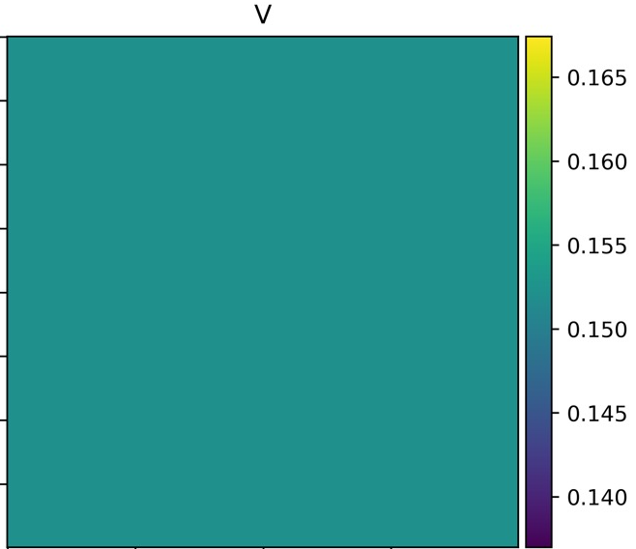
Notes:
Complexity in order: 1.3MB -> 900KB -> 700KB -> 600KB -> 450 -> 150KB

Slide 20
Conclusion & Discussion
Phase transitions still occur with objects
Convergence of phases seemed to take longer
Insufficient number of simulations to make definitive conclusions
The classification done by people
Notes:
We see that the phase transitions still occur, even with object. But we need more iterations for them to be sure. The rate of convergence seems to be lower as significantly more iterations were needed. A more robust method to find the influence of the object would be to be more extensive, different shapes, sizes but due to time constraints this was not possible. Also classification was done by people given the possibilty for. CORNERING

Slide 21
Discussion
Model still unrealistic
Add multiple objects
Different shapes of objects
Different initial conditions
Concluded by eye-balling result

